Slide 1
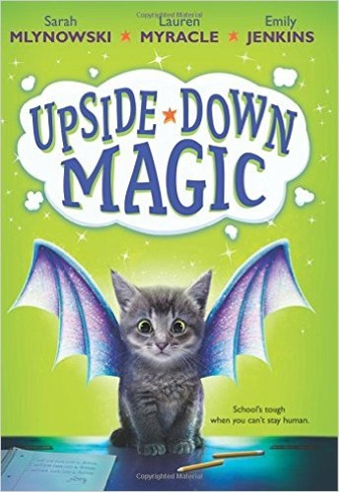
Upside-Down Magic
Written by Sarah Mlynowski, Lauren Myracle, and Emily Jenkins
Report by Julia
"Upside+down+magic+sage+academy - Google Search." Upside+down+magic+sage+academy - Google Search. N.p., n.d. Web. 27 Feb. 2016.

Slide 2
Describing the Book
The genre of this book is fantasy.
The theme/moral is be happy with who you are.
The plot development is man vs. magic or Nory vs. magic.
The challenge in the book is uncontrollable magic. The students with uncontrollable magic feel like they are outsiders. Ms. Starr fixes the problem by teaching her students that their magic is special.

Slide 3
Characters
Main characters- Nory [turns into animals], Ms. Starr-dark colored skin, good posture [has magic], Sebastian- blonde, freckles[sees soundwaves], Elliott- curly hair, tall, pale[freezes things], Andres- shaggy hair[can fly], Bax- short hair [turns into objects], Pepper – small, thick black hair[scares animals], Marigold- hearing aid[shrinks things], and Willa- blonde, braces[makes it rain inside]
Minor characters- Aunt Margo- cheerful [can fly], Dalia- 13 [manipulates animals], Hawthorn- 16, likes sports and cooking [manipulates fire], Nory’s father- serious[turn things invisible], and the Sparkies (Lacey- big glasses, tiny hands, Zinnia, Rune) [manipulates fire]
Protagonist-Nory
Antagonist-The Sparkies

Slide 4
Characters Continued
Stereotypically good- Nory [friendly], Ms. Starr [helps students appreciate their magic], Elliott [helpful], Sebastian [obedient], Andres [helpful], Bax [friendly], Pepper [kind], Marigold [considerate], and Willa [appreciative]
Stereotypically evil- The Sparkies [make fun of people] and Nory’s father [sent Nory away]
Four words to describe Nory are positive, courageous, perseveres, and friendly
Four words to describe Elliott are friendly, talkative, caring, and self conscious

Slide 5
Setting
Places
Dunwiddle school- white walls, fire extinguishers everywhere
Aunt Margo’s house- not clean but not messy, pretty empty
Nory’s house- matching/high quality front rooms, cluttered back rooms
Sage Academy- made of stone, paintings of mythical creatures, seats made of dark purple velvet
Time
present

Slide 6
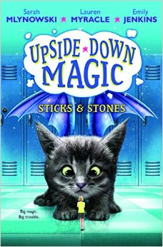
More Upside-down magic!
"Upside+down+magic+sage+academy - Google Search." Upside+down+magic+sage+academy - Google Search. N.p., n.d. Web. 27 Feb. 2016.

